Slide 1
Relational Algebra & Relational Calculus

Slide 2
Introduction
Relational algebra & relational calculus
  formal languages associated with the relational model
Relational algebra
  (high-level) procedural language
Relational calculus
  non-procedural language.
A language that produces a relation that can be derived using relational calculus is relationally complete

Slide 3
Relational Algebra
Operations work on one or more relations to define another relation without changing original relations
Operands and results are relations
Allows nested expressions
  Closure property

Slide 4
Relational Algebra
Five basic operations:
  Selection, Projection, Cartesian product, Union, Set difference
  Perform most of data retrieval operations needed
Other operations can be expressed in terms of basic operations
  Join, Intersection, and Division

Slide 5
Selection
Selection aka restriction
σ_{predicate} (R)
  Unary operation
  Defines a relation that contains only those tuples (rows) of R that satisfy specified condition (predicate)
  Predicate can include all logical operators
    AND, OR, NOT

Slide 6
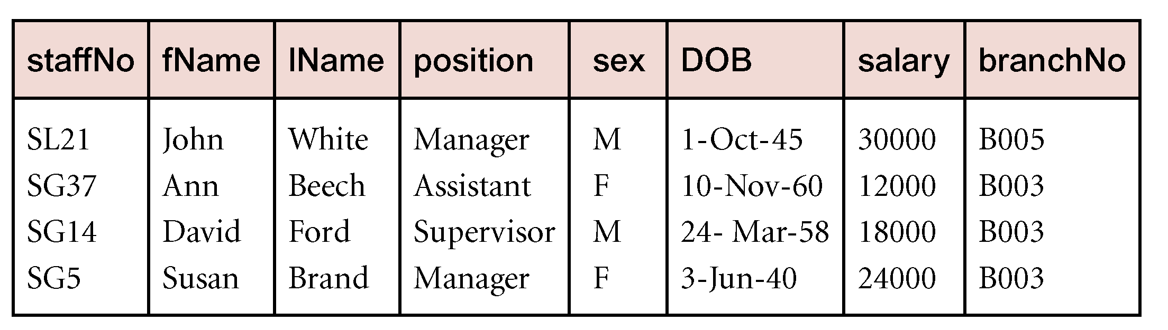
Selection Example
List all staff with a salary greater than £10,000.
  σ_{salary > 10000} (Staff)

Slide 7
Projection
Π_{col1, . . . , coln}(R)
  Unary operation
  Defines a relation that contains a vertical subset of R,
    Values of specified attributes extracted
    Duplicates eliminated

Slide 8
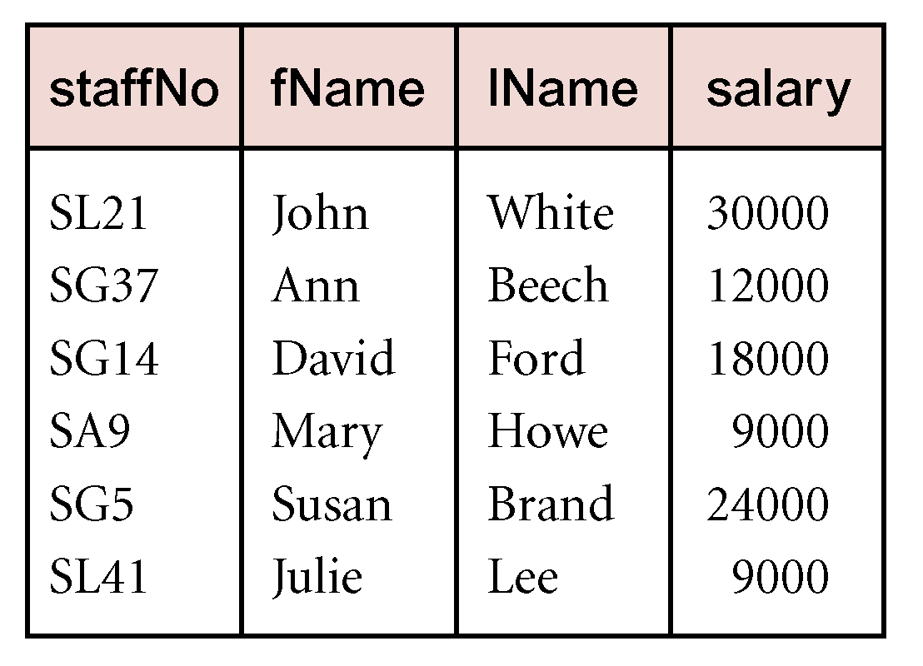
Projection Example
Produce a list of salaries for all staff, showing only staffNo, fName, lName, and salary details.
  Π_{staffNo, fName, lName, salary}(Staff)

Slide 9
Union
R ∪ S
  Binary operation
  Defines a relation that contains all the tuples of R, or S, or both R and S
  Duplicate tuples eliminated
  R and S must be union-compatible
For relations R and S with I and J tuples, respectively
  Union is concatenation of R & S into one relation with maximum of (I + J) tuples

Slide 10
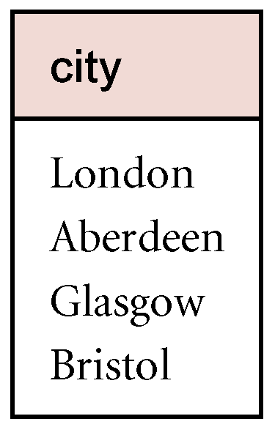
Union Example
List all cities where there is either a branch office or a property for rent.
  Π_{city}(Branch) ∪ Π_{city}(PropertyForRent)

Slide 11
Set Difference
R – S
  Binary operation
  Defines a relation consisting of tuples in relation R, but not in S
  R and S must be union-compatible

Slide 12
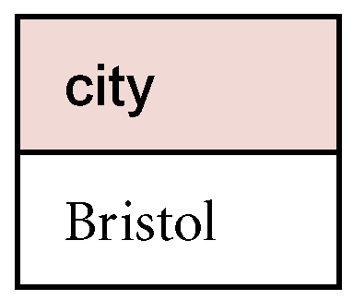
Set Difference Example
List all cities where there is a branch office but no properties for rent.
  Π_{city}(Branch) – Π_{city}(PropertyForRent)

Slide 13
Intersection
R ∩ S
  Binary operation
  Defines a relation consisting of the set of all tuples in R and S
  R and S must be union-compatible
Expressed using basic operations:
  R ∩ S = R – (R – S)

Slide 14
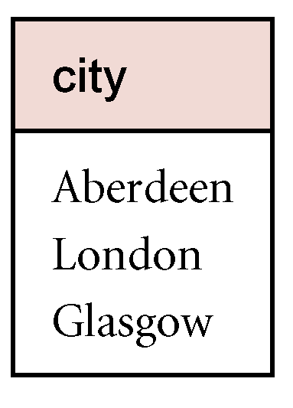
Intersection Example
List all cities where there is both a branch office and at least one property for rent.
  Π_{city}(Branch) ∩ Π_{city}(PropertyForRent)

Slide 15
Cartesian Product
R X S
  Binary operation
  Defines relation that is concatenation of every tuple of relation R with every tuple of relation S

Slide 16
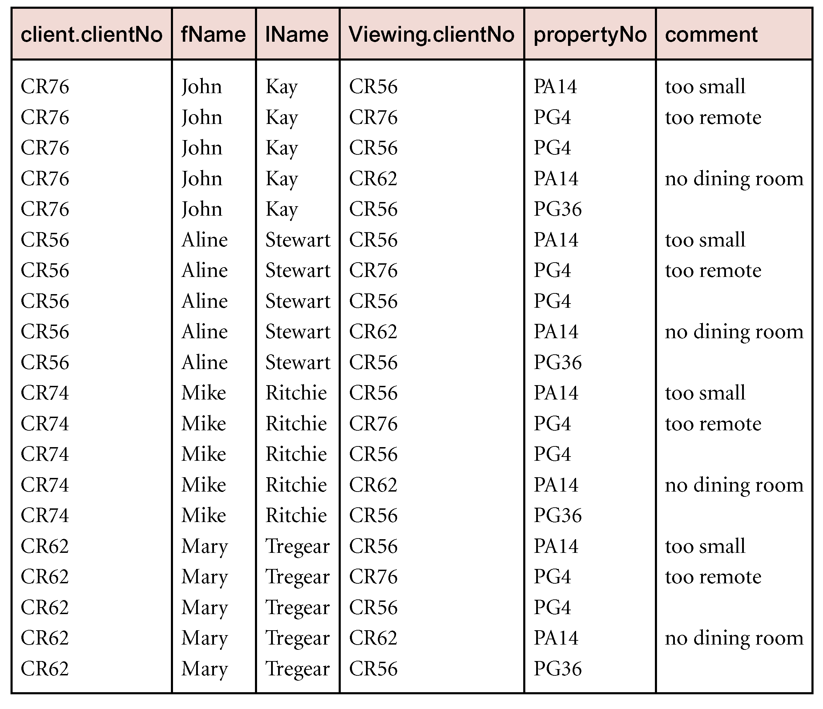
Cartesian Product Example
List the names and comments of all clients who have viewed a property for rent.
  (Π_{clientNo, fName, lName}(Client)) X (Π_{clientNo, propertyNo, comment} (Viewing))

Slide 17
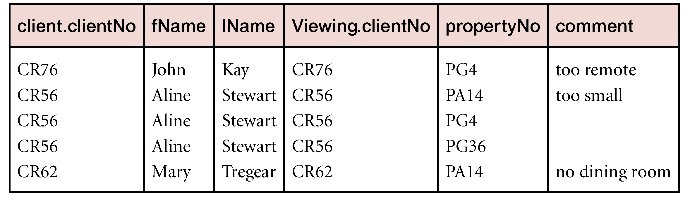
Examples: Cartesian Product and Selection
Use selection operation to extract those tuples where Client.clientNo = Viewing.clientNo.
  σClient.clientNo = Viewing.clientNo((∏_{clientNo, fName, lName}(Client)) Χ (∏_{clientNo, propertyNo, comment}(Viewing)))
Cartesian product and Selection reducible to single operation - Join

Slide 18
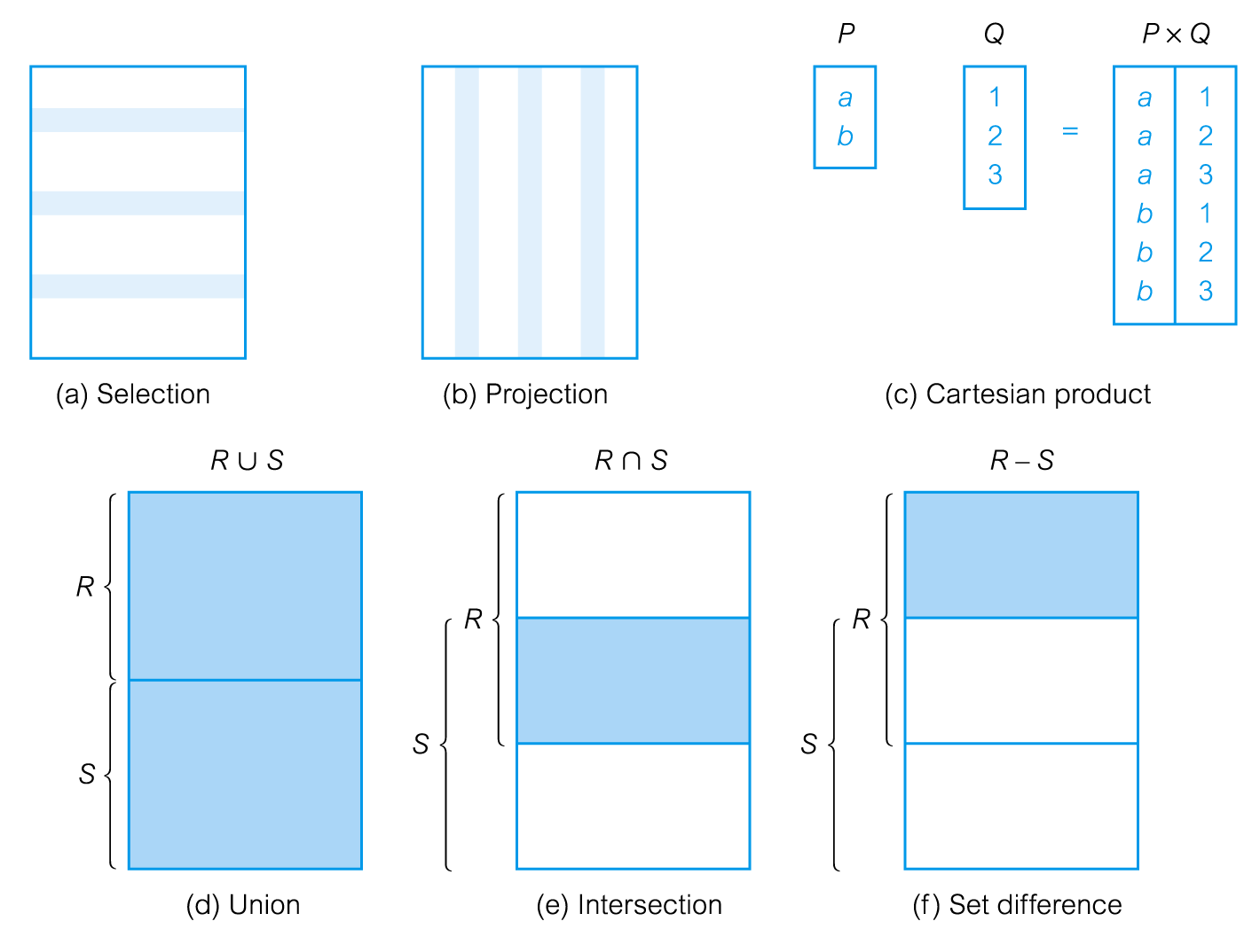
Relational Algebra Operations

Slide 19
Join Operations
Join
  Derivative of Cartesian product
  Equivalent to Selection, using join predicate as selection formula, over Cartesian product of two operand relations
  One of most difficult operations to implement efficiently in an RDBMS
  One reason RDBMSs have intrinsic performance problems

Slide 20
Join Operations
Join operations
  Theta join
  Equijoin (specific type of Theta join)
  Natural join
  Outer join
  Semijoin

Slide 21
Theta join (θ-join)
R _{F}S
  Defines a relation that contains tuples satisfying predicate F from Cartesian product of R and S
  The predicate F is of the form R.a_{i} θ S.b_{i} where θ may be one of the comparison operators (<, ≤, >, ≥, =, ≠).

Slide 22
Theta join (θ-join)
Theta join rewritten using Selection and Cartesian product operations
    R _{F}S = σ_{F}(R Χ S)
Degree of a Theta join
  Sum of degrees of the operand relations R and S
  If predicate F contains only equality (=), called Equijoin

Slide 23
Equijoin Example
List the names and comments of all clients who have viewed a property for rent.
  (Π_{clientNo, fName, lName}(Client)) Client.clientNo = Viewing.clientNo (Π_{clientNo, propertyNo, comment}(Viewing))

Slide 24
Natural Join
R S
  Equijoin of two relations R and S over all common attributes x
  One occurrence of each common attribute eliminated from result

Slide 25
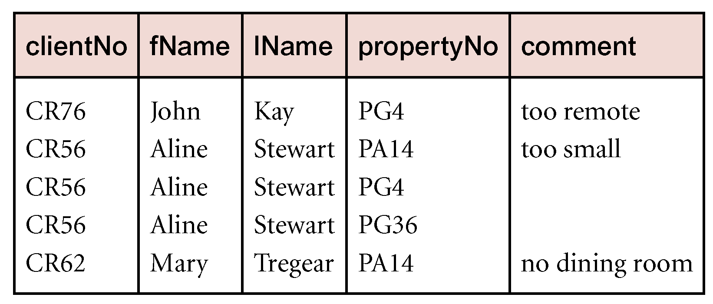
Natural Join Example
List the names and comments of all clients who have viewed a property for rent.
  (Π_{clientNo, fName, lName}(Client)) Client.clientNo = Viewing.clientNo (Π_{clientNo, propertyNo, comment}(Viewing))

Slide 26
Outer Join
Displays rows that do not have matching values in the join column
R S
  (Left) outer join - tuples from R that do not have matching values in common columns of S included in result relation
  Missing values in S -> set to NULL

Slide 27
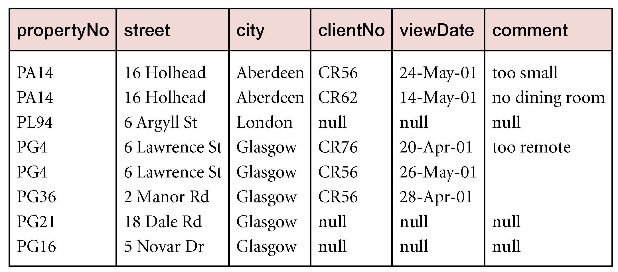
Left Outer Join Example
Produce a status report on property viewings.
  Π_{propertyNo, street, city}(PropertyForRent)
  Viewing

Slide 28
Semi Join
R _{F} S
  Defines relation that contains tuples of R that participate in join of R with S
Can rewrite Semijoin using Projection and Join:
  R _{F} S = Π_{A}(R _{F} S)

Slide 29
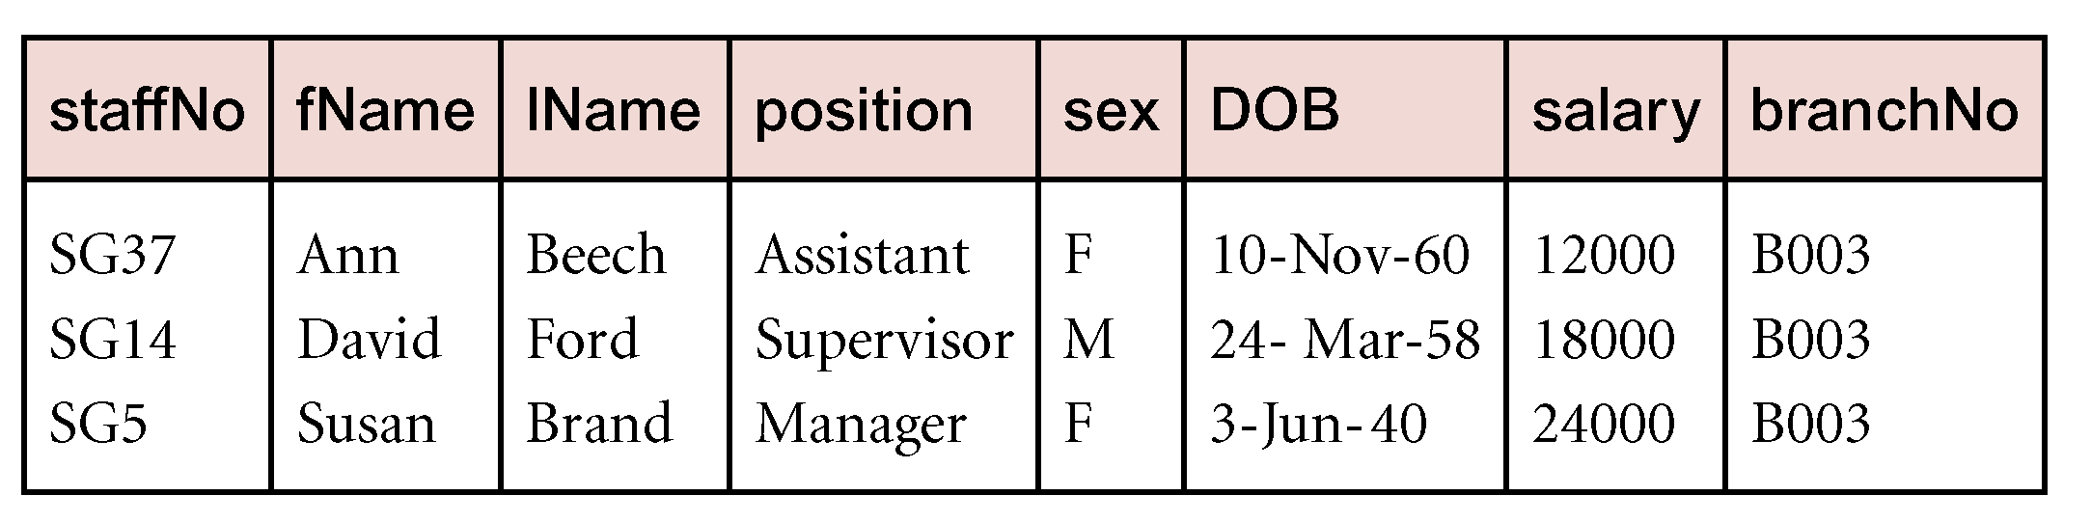
Semijoin Example
List complete details of all staff who work at the branch in Glasgow.
  Staff _{Staff.branchNo=Branch.branchNo}(σ_{city=‘Glasgow’}(Branch))

Slide 30
Division
R ÷ S
  Defines a relation over attributes C that consists of set of tuples from R that match combination of every tuple in S
Expressed using basic operations:
  T₁ ← Π_{C}(R)
  T₂ ← Π_{C}((S X T₁) – R)
  T ← T₁ – T₂

Slide 31
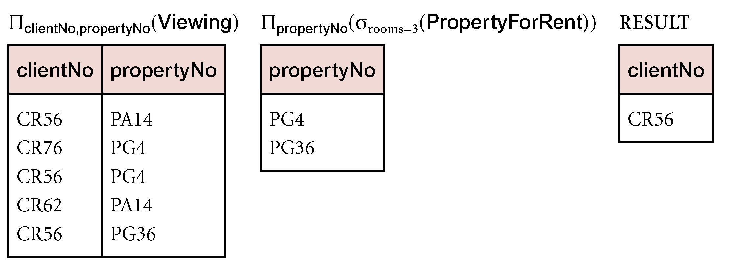
Division Example
Identify all clients who have viewed all properties with three rooms.
  (Π_{clientNo, propertyNo}(Viewing)) ÷
  (Π_{propertyNo}(σ_{rooms = 3} (PropertyForRent)))

Slide 32
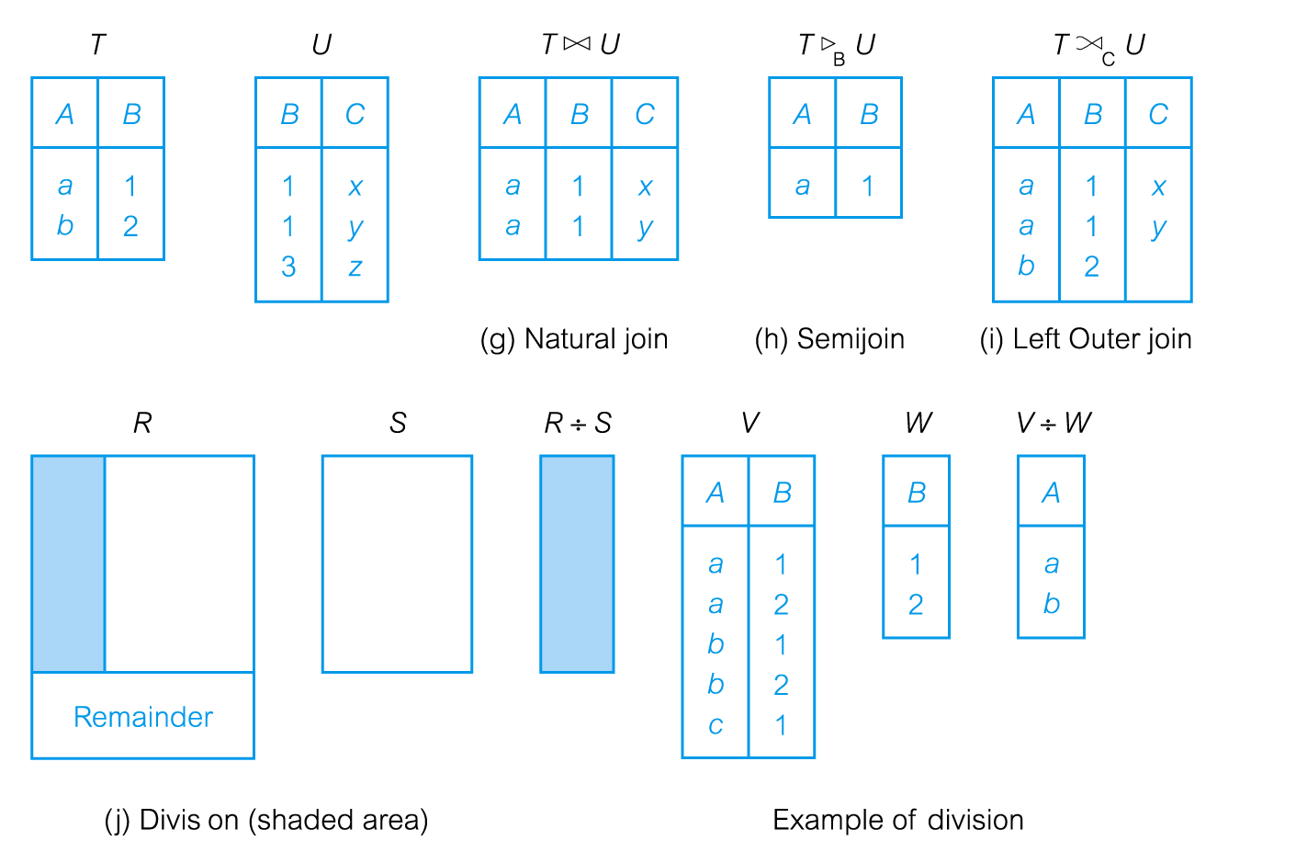
Relational Algebra Operations

Slide 33
Aggregate Operations
ℑ_{AL}(R)
  Applies aggregate function list (AL) to R to define relation over aggregate list
  AL contains one or more (<aggregate_function>, <attribute>) pairs
Main aggregate functions
  COUNT, SUM, AVG, MIN, and MAX

Slide 34
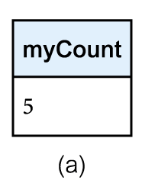
Aggregate Operations Example
How many properties cost more than £350 per month to rent?
  ρ_{R}(myCount) ℑ_{COUNT} _{propertyNo} (σ_{rent > 350} (PropertyForRent))

Slide 35
Grouping Operations
_{GA}ℑ_{AL}(R)
  Groups tuples of R by grouping attributes (GA) then applies aggregate function list (AL) to define new relation
  Resulting relation contains grouping attributes (GA) and results of each aggregate function

Slide 36
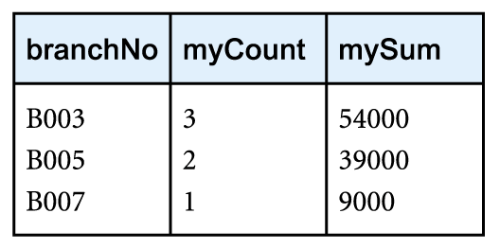
Grouping Operation Example
Find the number of staff working in each branch and the sum of their salaries.
  ρ_{R}(branchNo, myCount, mySum)
  _{branchNo} ℑ _{COUNT staffNo,} _{SUM salary} (Staff)

Slide 37
Order of Preference
Precedence of relational operators:
  [σ, π, ρ] (highest)
  [Χ, ⋈]
  ∩
  [∪, —]

Slide 38
Relational Calculus
Relational calculus query specifies what is to be retrieved rather than how to retrieve it
  No description of how to evaluate a query
In first-order logic (or predicate calculus), predicate is a truth-valued function with arguments
Proposition
  Substitution of values for arguments in predicate
  Can be either true or false

Slide 39
Relational Calculus
If predicate contains a variable, must be range for x
Substitution of some values of range for x, proposition may be true; for other values, false
When applied to databases, relational calculus has forms: tuple and domain

Slide 40
Tuple Relational Calculus
Finds tuples for which predicate is true
Uses tuple variables
Tuple variable
  Variable that ‘ranges over’ a named relation: i.e., variable whose only permitted values are tuples of the relation
Specify range of a tuple variable S as the Staff relation as:
  Staff(S)
To find set of all tuples S such that F(S) is true:
  {S | F(S)}
  where F is a formula

Slide 41
Tuple relational Calculus Example
To find details of all staff earning more than £10,000:
  {S | Staff(S) ∧ S.salary > 10000}
To find a particular attribute, such as salary, write:
  {S.salary | Staff(S) ∧ S.salary > 10000}

Slide 42
Tuple Relational Calculus
Quantifiers - tell how many instances the predicate applies to:
  Existential quantifier ∃ (‘there exists’)
  Universal quantifier ∀ (‘for all’)
Tuple variables qualified by ∀ or ∃ are called bound variables, otherwise called free variables

Slide 43
Tuple Relational Calculus
Existential quantifier used in formulae that must be true for at least one instance, such as:
  Staff(S) ∧ (∃B)(Branch(B) ∧
  (B.branchNo = S.branchNo) ∧ B.city = ‘London’)
Translation:
  ‘There exists a Branch tuple with same branchNo as the branchNo of the current Staff tuple, S, and is located in London’

Slide 44
Tuple Relational Calculus
Universal quantifier is used in statements about every instance, such as:
  (∀B) (B.city ≠ ‘Paris’)
Translation:
  ‘For all Branch tuples, the address is not in Paris’
Can also use ~(∃B) (B.city = ‘Paris’)
Translation:
  ‘There are no branches with an address in Paris’

Slide 45
Tuple Relational Calculus
Formulae should be unambiguous and make sense
A (well-formed) formula is made out of atoms:
    R(S_{i}), where S_{i} is a tuple variable and R is a relation
    S_{i}.a₁ θ S_{j}.a₂
    S_{i}.a₁ θ c
Can recursively build up formulae from atoms:
    An atom is a formula
    If F₁ and F₂ are formulae, so are their conjunction, F₁ ∧ F₂; disjunction, F₁ ∨ F₂; and negation, ~F₁
    If F is a formula with free variable X, then (∃X)(F) and (∀X)(F) are also formulae

Slide 46
Tuple Relational Calculus Example
List the names of all managers who earn more than £25,000.
  {S.fName, S.lName | Staff(S) ∧
  S.position = ‘Manager’ ∧ S.salary > 25000}
List the staff who manage properties for rent in Glasgow.
  {S | Staff(S) ∧ (∃P) (PropertyForRent(P) ∧ (P.staffNo = S.staffNo) ∧ P.city = ‘Glasgow’)}

Slide 47
Tuple Relational Calculus Example
List the names of staff who currently do not manage any properties.
  {S.fName, S.lName | Staff(S) ∧ (~(∃P) (PropertyForRent(P)∧(S.staffNo = P.staffNo)))}
Or
  {S.fName, S.lName | Staff(S) ∧ ((∀P) (~PropertyForRent(P) ∨
  ~(S.staffNo = P.staffNo)))}

Slide 48
Tuple Relational Calculus Example
List the names of clients who have viewed a property for rent in Glasgow.
  {C.fName, C.lName | Client(C) ∧ ((∃V)(∃P)
  (Viewing(V) ∧ PropertyForRent(P) ∧
  (C.clientNo = V.clientNo) ∧
  (V.propertyNo=P.propertyNo) ∧
  P.city =‘Glasgow’))}

Slide 49
Tuple Relational Calculus
Expressions can generate infinite set
  Example
  {S | ~Staff(S)}
Eliminate by:
  Adding restriction that all values in result must be values in domain of expression E, dom(E)
Domain of E
  Set of all values that appear explicity in E or in relations whose names appear in E

Slide 50
Domain Relational Calculus
Uses variables that take values from domains
A general domain relational calculus expression:
  {d₁, d₂, . . . , d_{n} | F(d₁, d₂, . . . , d_{n})}
    R(d_{i}), where d_{i} is a domain variable and R is a relation
    d_{i} θ d_{j}
    d_{i} θ c
Can recursively build up formulae from atoms:
    An atom is a formula
    If F₁ and F₂ are formulae, so are their conjunction, F₁ ∧ F₂; disjunction, F₁ ∨ F₂; and negation, ~F₁
    If F is a formula with free variable X, then (∃X)(F) and (∀X)(F) are also formulae

Slide 51
Domain Relational Calculus Example
Find the names of all managers who earn more than £25,000.
  {fN, lN | (∃sN, posn, sal)
  (Staff (sN, fN, lN, posn, sex, DOB, sal, bN) ∧
  posn = ‘Manager’ ∧ sal > 25000)}

Slide 52
Domain Relational Calculus Example
List the staff who manage properties for rent in Glasgow.
  {sN, fN, lN, posn, sex, DOB, sal, bN |
  (∃sN1,cty)(Staff(sN,fN,lN,posn,sex,DOB,sal,bN) ∧
  PropertyForRent(pN, st, cty, pc, typ, rms,
  rnt, oN, sN1, bN1) ∧
  (sN=sN1) ∧ cty=‘Glasgow’)}

Slide 53
Domain Relational Calculus Example
List the names of staff who currently do not manage any properties for rent.
  {fN, lN | (∃sN)
  (Staff(sN,fN,lN,posn,sex,DOB,sal,bN) ∧
  (~(∃sN1) (PropertyForRent(pN, st, cty, pc, typ, rms, rnt, oN, sN1, bN1) ∧ (sN=sN1))))}

Slide 54
Domain Relational Calculus Example
List the names of clients who have viewed a property for rent in Glasgow.
  {fN, lN | (∃cN, cN1, pN, pN1, cty)
  (Client(cN, fN, lN,tel, pT, mR) ∧
  Viewing(cN1, pN1, dt, cmt) ∧
  PropertyForRent(pN, st, cty, pc, typ, rms, rnt,oN, sN, bN) ∧
  (cN = cN1) ∧ (pN = pN1) ∧ cty = ‘Glasgow’

Slide 55
Other Languages
Transform-oriented languages
  Non-procedural languages
  Use relations to transform input data into required outputs (e.g. SQL)
Graphical languages
  Provide user with picture of structure of relation
  User fills in example of what is wanted and system returns required data in that format (e.g. QBE)

Slide 56
Other Languages
4GLs
  Create complete customized application
  Uses limited set of commands in a user-friendly, often menu-driven environment
Some systems accept a form of natural language, sometimes called a 5GL, although this development is still at an early stage

Slide 57
In-Class Exercises:
Convert to Relational Algebra
  List the names of all managers who earn more than £25,000.
    {S.fName, S.lName | Staff(S) ∧ S.position = ‘Manager’ ∧ S.salary > 25000}
  List the staff who manage properties for rent in Glasgow.
    {S | Staff(S) ∧ (∃P) (PropertyForRent(P) ∧ (P.staffNo = S.staffNo) ∧ P.city = ‘Glasgow’)}
  List the names of clients who have viewed a property for rent in Glasgow.
  {C.fName, C.lName | Client(C) ∧ ((∃V)(∃P) (Viewing(V) ∧ ropertyForRent(P)
  ∧ (C.clientNo = V.clientNo) ∧ (V.propertyNo=P.propertyNo) ∧ P.city =‘Glasgow’))}

